Slide 1
FLIGHT PRICE PREDICTION
DSE-GGN-APR’21-Grp1
Abhinav Sagar Punni
Akanksha Saraswat
Akarsh Chauhan
Mohnish Kumar
Rishabh Chawla

Slide 2

Overview
Objective
Business Problem
Data Processing
EDA - Dashboard
Feature Engineering
Model Evaluation & Assumption
Regression Models Comparison
Limitation and Future Scope

Slide 3
Business Objective and Understanding
Problem Statement
Why it is important
The aim of our project is to build a predictive model and find out the flight prices of each Airline for a particular journey.
Purchasing airline ticket at optimal price from the consumer’s perspective is quite challenging because buyers have insufficient information for reasoning about future price movements.
Value Addition
Future Scope
Solution
People who travel most frequently will be able to save a considerable amount of money and hence it will surely be profitable for both the customers and organizations providing such analysis.
When Our model goes into production , it will help the Airline companies to Identify their High revenue flights and target groups like Business, Leisure, Tourists etc.
Model will help consumers understand the best times to purchase the tickets and Flight trends. Model will provide the option to book ticket at lowest price anytime knowing the predicted values.

Slide 4
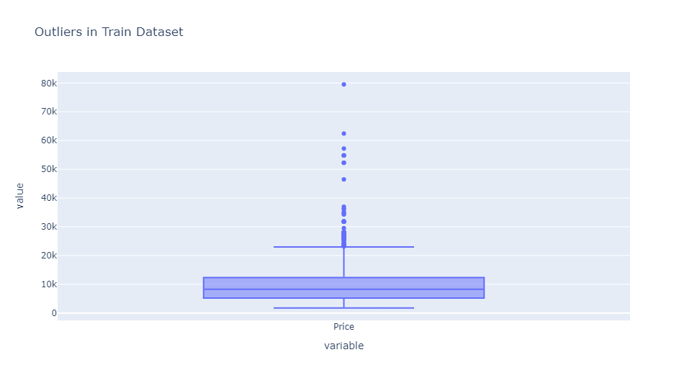
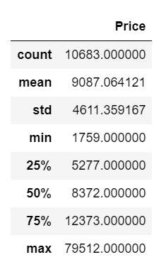
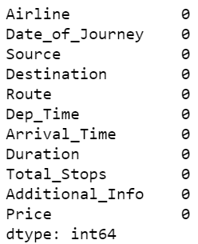
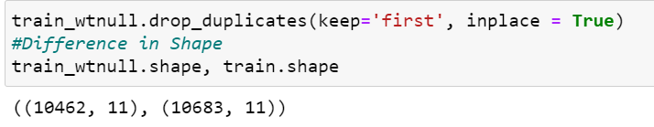
Data Processing
Data Description
Outlier Treatment
Initially our dataset contain 14000 records (approx) and 11 features, having 10 categorical and 1 numerical column (target variable )
We check outliers using IQR technique and target variable has 0.10 % outliers. so we remove the outliers.
Handling Missing Values
Duplicates
We have approximately no missing values in our dataset. It is safe to drop the null value record since it is less than 0.01 % .
Our data contained 220 duplicate records which was deleted as part of data cleaning.

Slide 5
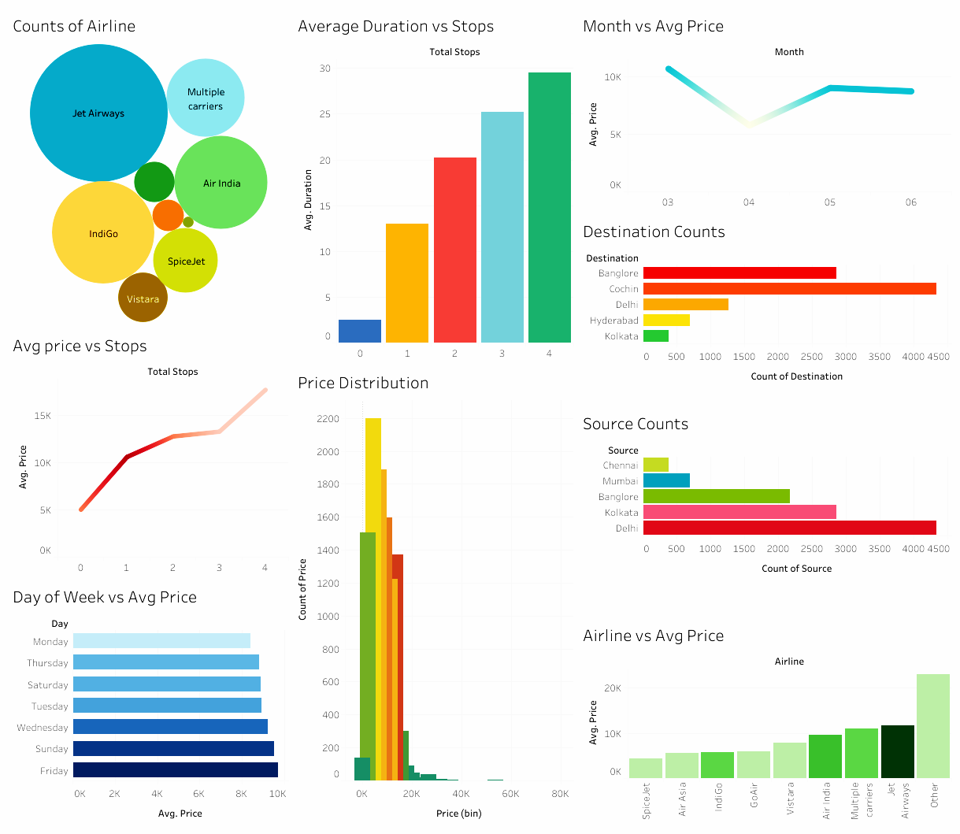
Validating Inferences Using Visualizations

Slide 6
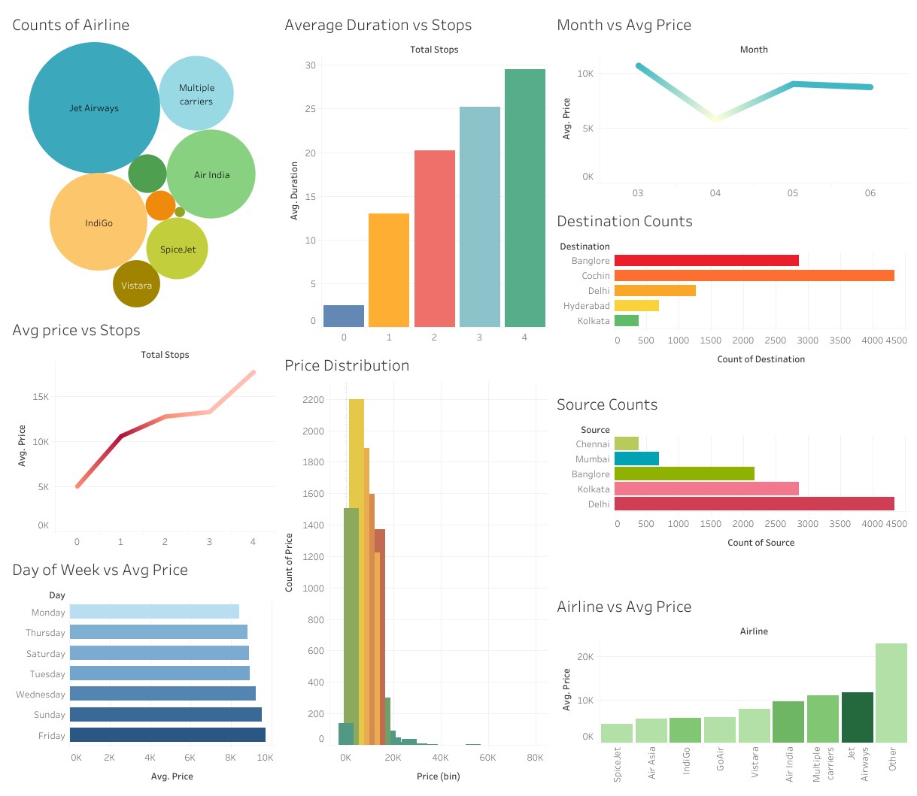
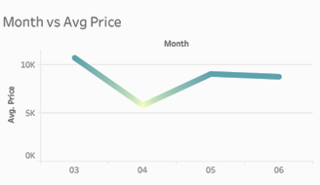


Slide 7
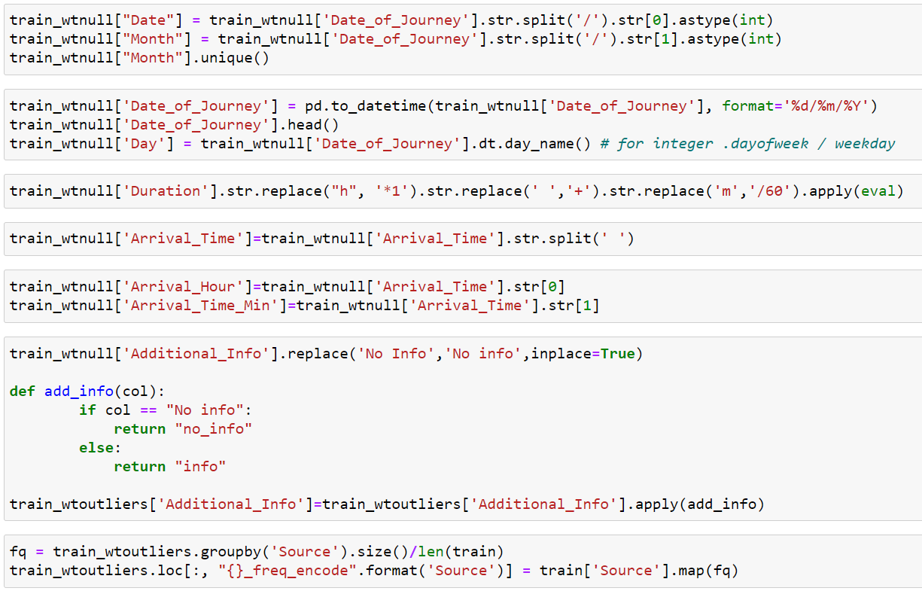
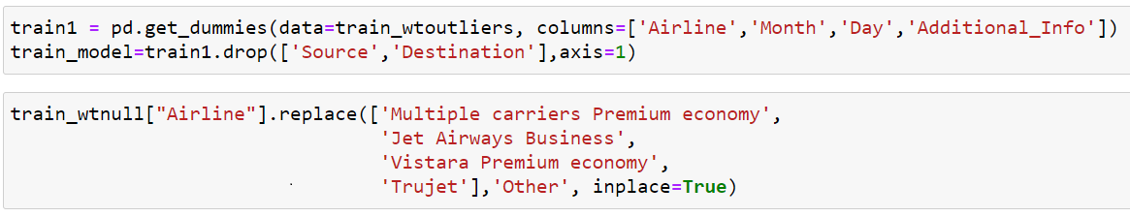
Feature Eng.
Overview:
In machine learning algorithms, we cannot use date and categorical formatted data directly. Hence, we need to perform the feature engineering on such columns and extract the required features from it.
Columns:
Convert routes and fight stops , arrival time.
Extract day and month from date column
Handling Duration, Airline and additional info columns.
Encoding Airline, Day, Additional Info, Source, Destination .

Slide 8
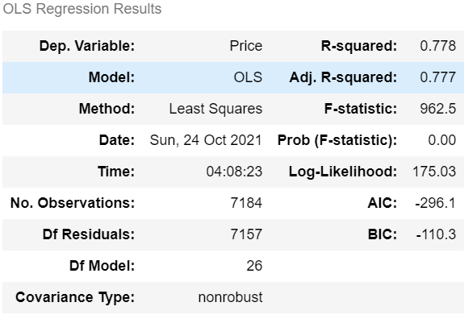
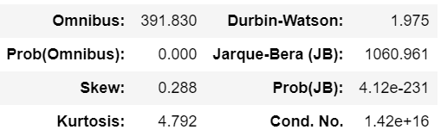
Base Model
R2
0.777
0.766
Error(RMSE)
2361.467535
2423.968554
Model
OLS Model(Train)
OLS Model(Test)

Slide 9
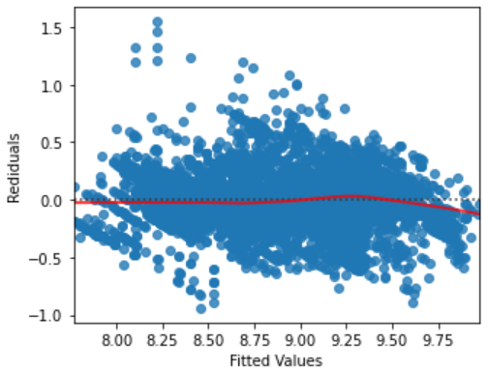
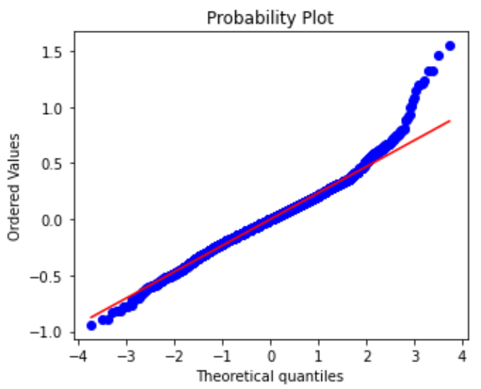
Base Model Assumptions
LINEARITY
Data is Linear
Data is not Linear
Rainbow Test
F-Stats : 0.9901
0.6385 (P>0.05)
Ho
H1
Test
Test - Stat
P-value
NORMALITY
Data is Normal
Data is not Normal
Shapiro
F-Stats : 0.985 (F-Stats > 0.05)
1.3892e-26 (Will not consider P-Value as dataset has > 5000 rows)

Slide 10
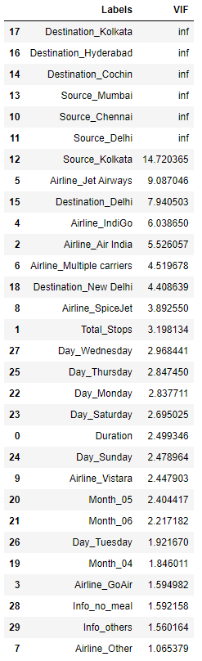
Base Model Assumptions
Ho
H1
Test
Test - Stat
P-value
HETERO SKEDASTICITY
Residuals have equal variance
Residuals do not have equal variance
Breusch Pagan Test
F-Stats : 6.038983e+01
6.116137e-284 P<0.05
AUTO CORRELATION
Residuals are not Auto-Correlated
Residuals are Auto-Correlated
Durbin Watson
DW-Stats : 1.975
-
MULTI -COLLINEARITY
Independent Variables have correlation
Independent Variables have no correlation
VIF
-
-

Slide 11
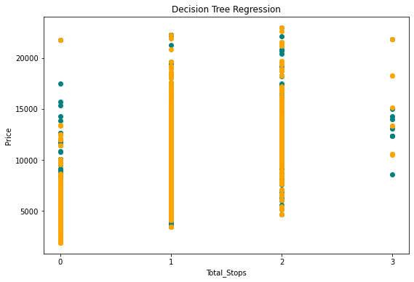
Decision Tree Regressor Performance Metrics
RMSE - Test
2341.12
R2 (Test)
0.7817
RMSE (Train)
978.347
R2 (Train)
0.9618
Model
Decision Tree

Slide 12
Random Forest Model
R2(Train) | RMSE - Train
96.182 | 978.347
R2(Test) | RMSE - Test
78.177 | 2341.12
Model
Decision Tree
R2(Train) | RMSE - Train
95.197 | 1097.429692
R2(Test) | RMSE - Test
84.916 | 1946.379931
Model
Random Forest

Slide 13
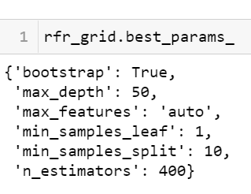
Hyperparameter Optimization Using Grid Search CV
Best Parameters
Tuning parameters of random forest for the model’s better performance.
Initialization and Fitting the Random Forest Model again using best parameters.
Model | R2 (Train) | RMSE (Train)
Random Forest (Best Params) | 92.708 | 1351.607
R2 (Test) | RMSE (Test)
86.993 | 1809.876

Slide 14
Gradient Boosting Performance Metrics
Model | R2 (Train) | RMSE (Train) | R2 (Test) | RMSE (Test)
Gradient Boosting Regressor | 91.996 | 1416.632 | 87.277 | 1787.53
Model | R2 (Train) | RMSE (Train) | R2 (Test) | RMSE (Test)
Extreme Gradient Boosting Regressor | 91.699 | 1442.7485 | 87.174 | 1794.7816

Slide 15
Light Gradient Boosting Regressor
Light GBM is a fast, distributed, high-performance gradient boosting framework based on decision tree algorithm
The validation score of LGBM (R2=0.8847, RMSE=0.173) was the best out of all the above models.
Model | R2 (Train) | RMSE (Train) | R2 (Test) | RMSE (Test)
Light Gradient Boosting Regressor | 91.039 | 1500.46 | 88.139 | 1758.93

Slide 16
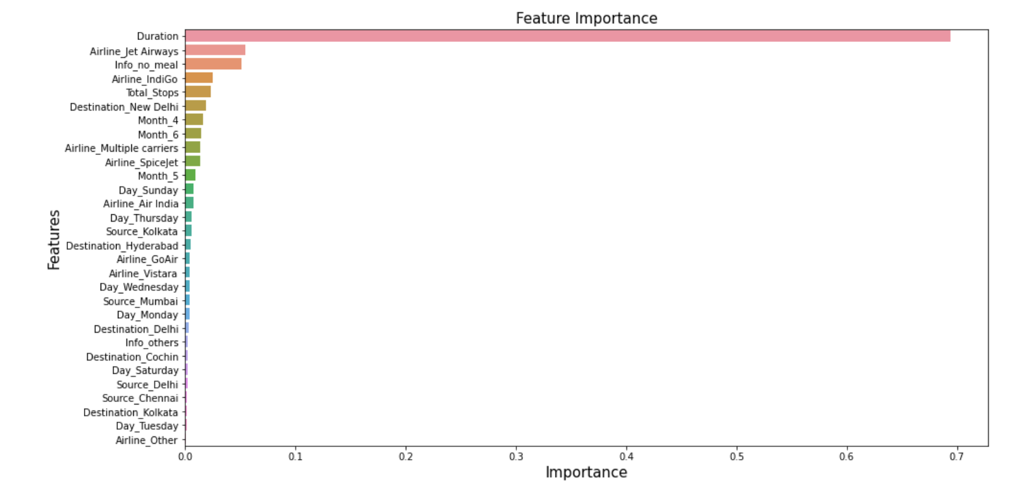
Best Features
Features that have significant impact on Price Prediction
Duration Of the Journey
Airlines: Jet Airways and Indigo
Info no meal included
Total Stops
Month April and July
Destination New Delhi.

Slide 17
R2-Score v/s Cross-Val Score
Model | R2 (Train) | Cross-Val R2 (Train) | R2 (Test) | Cross-Val R2 (Test)
Decision Tree | 96.182 | 77.845 | 78.177 | 76.498
Random Forest | 95.197 | 84.862 | 84.916 | 83.685
Random Forest (Best Params) | 92.708 | 92.714 | 86.957 | 86.957
Gradient Boost | 91.996 | 87.707 | 87.277 | 84.729
X-Gradient Boost | 91.699 | 87.499 | 87.174 | 85.311
Light Gradient Boosting Regressor | 91.039 | 87.678 | 88.139 | 85.564

Slide 18
Limitation
Since the information related to additional info and available seats are unavailable thus either the customer ends up paying more money or else Airline Industries ends us with the lesser revenue.
Based on additional information a more accurate model could be built. Also Customers could be categorized into different groups like Business, Leisure, Tourists, etc. which can give useful information like which group of customers are willing to pay higher prices.
Also, our model gives predictions for the limited number of months because of partial months records.

Slide 19
Future Scope
Putting the model into production by incorporating a front end that also contains additional information like day and date of booking, class of the flight and layover duration, etc.
Also, a predictive analysis model can also be used in multiple domains like Electric Energy or Solar Energy consumption of a building or Power Plant, House Sales Price Prediction, Prediction Stock Prices, and Returns, etc.

Slide 20

Thank you
Thanks for your time and patience , we will welcome your feedbacks now.
We look forward to working together as a team .

